Slide 1


CAN WE PREDICT HOTEL BOOKING CANCELLATIONS ?
Analysis & Prediction of Hotel Booking Cancellation
With Ensemble Learning
Presented By
Name : H.H.J.Karunarathna
Index No : 18/ENG/050

Slide 2
Table of Content
Introduction
State of the Art
Methodology
Results
Conclusion
References

Slide 3
01.Introduction

Slide 4







Problem
Hotel industry is one of the faster growing businesses of tourism sector.
In 2019, worth over
$570B
Source : [1]
Rising rate of cancellation have a negative impact on the hotel industry.
Loss of income in shape of unsold room
Lower RevPAR
Operational problems
1 out of 4 guests are
$8.7B/Year
Cancelling
Source : [2]
From cancellations & no-shows
Source : [3]
To mitigate the impact of cancellations,
hotels must identify potentially cancelled bookings.
Notes:
In order to fight the negative effects of cancellations, hotels need to be able to identify which bookings are likely to be canceled.

Slide 5



Objectives
Build an ensemble learning-based classification model that predicts hotel booking cancellations with the highest possible accuracy.
Conduct an EDA to identify patterns in hotel booking cancellations.
Develop a REST API to expose the model's functionality through an HTTP endpoint.
Notes:
In order to fight the negative effects of cancellations, hotels need to be able to identify which bookings are likely to be canceled.

Slide 6
02.State of Art

Slide 7


Research Works | Data Used | Models Built | Addressing Class Imbalance | Ensemble Learning
Predicting Hotel Booking Cancellation To Decrease Uncertainty And Increase Revenue(2017) - Antonio Et.Al [4] | Real booking data from 4 hotels | Boosted Decision Trees, Decision Forest, Decision Jungle, Locally Deep Support Vector Machine, Neural Networks
An Automated Machine Learning Based Decision Support System to Predict Hotel Booking Cancellation (2019) - Antonio Et.Al [5] | All reservations on-the-books | XGBoost
Performance Analysis of Machine Learning Techniques to Predict Hotel Booking Cancellations in Hospitality Industry (2020) - Shagriarr Et.Al [6] | Real booking data from 2 hotels | XGBoost, Decision Tree, Gradient Boost, Random forest, Linear Regression, KNN
Solving the Problem of Class Imbalance in the Prediction of Hotel Cancellations (2021- Mohtd Et.Al [7] | Real booking data from 2 hotels | Linear Regression, Decision Tree, AdaBoost, Gradient Boost, Random forest

Slide 8
03.Methodology

Slide 9
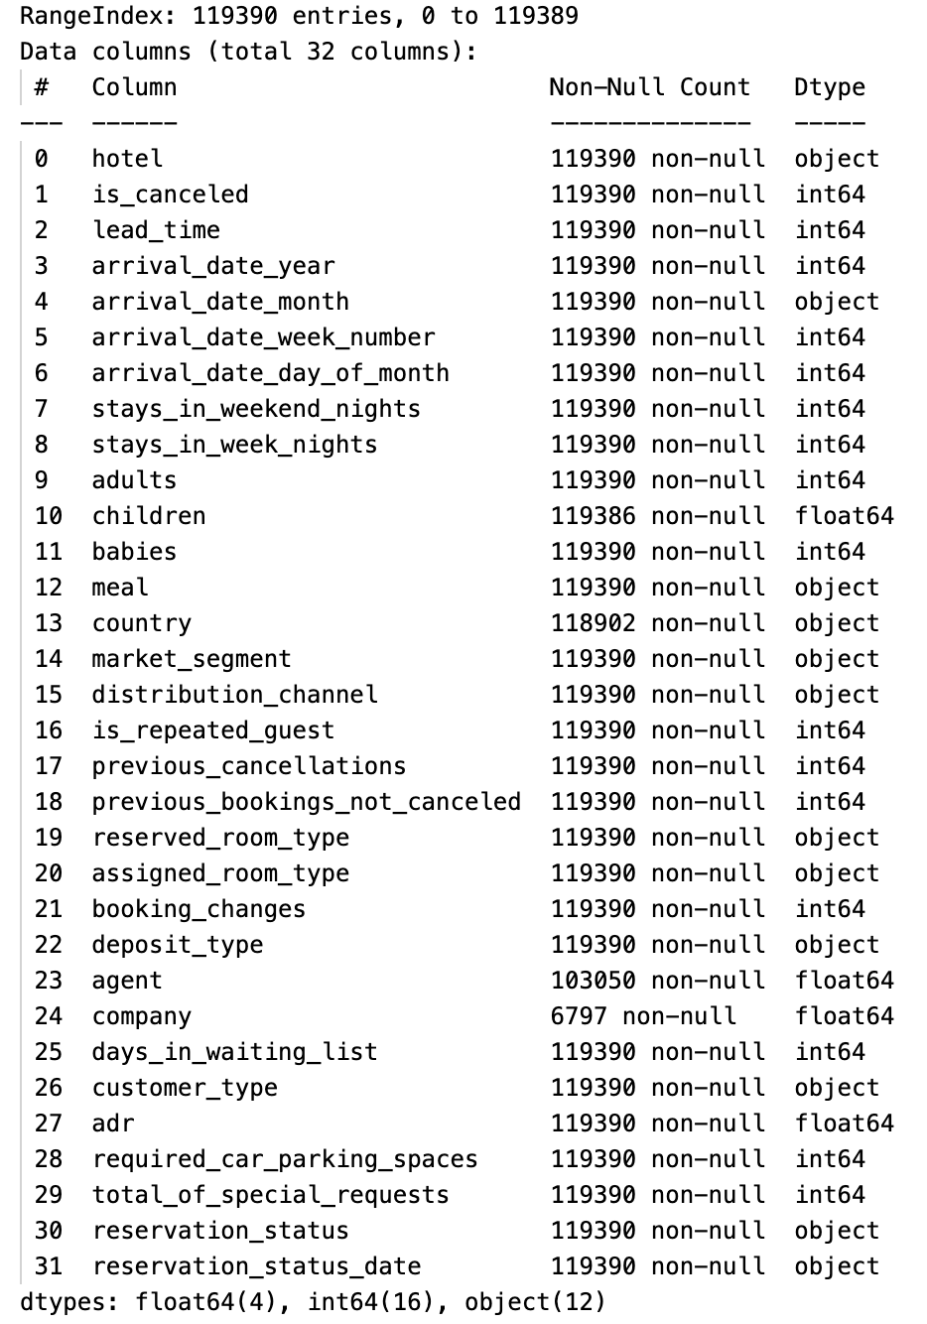
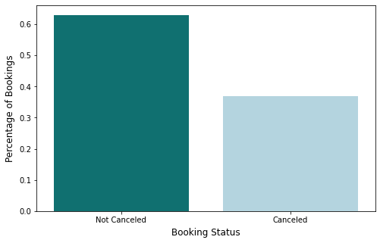
01.Data Selection
Dataset
Size
Imbalance
:
:
:
Open hotel booking demand dataset
Created by Antonio, Almeida and Nunes ,2019
Records related to both a Resort Hotel & City Hotel
32 columns & ~120K observations
Slightly imbalanced
63%
37%

Slide 10
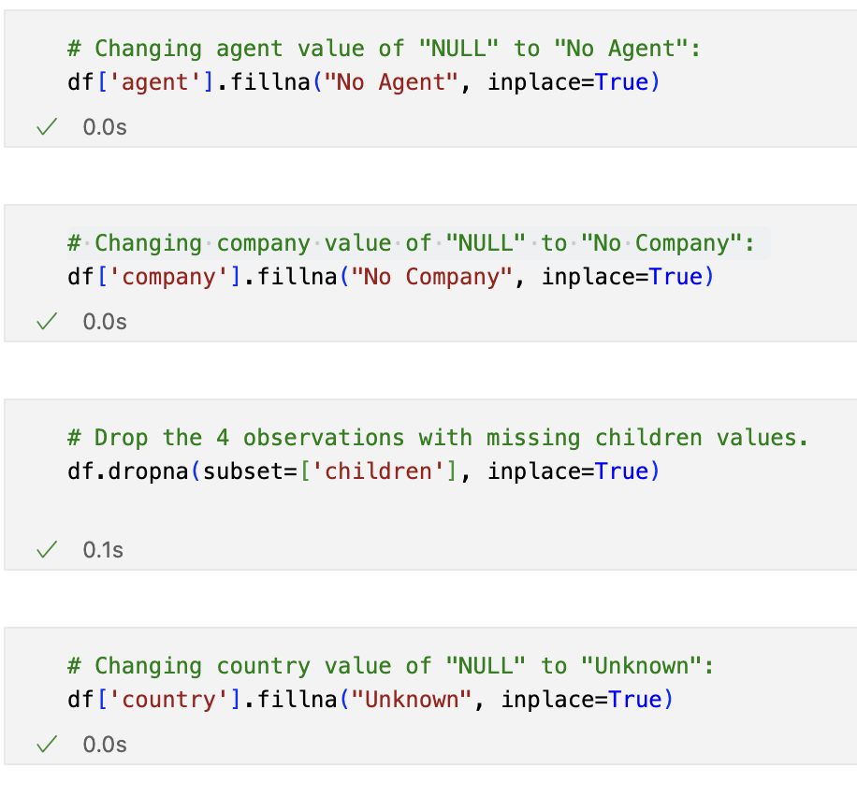
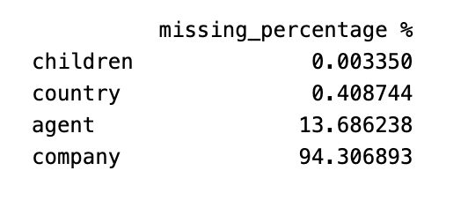
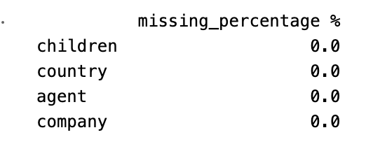
02. Data Cleaning
01. Handling Missing Values

Slide 11
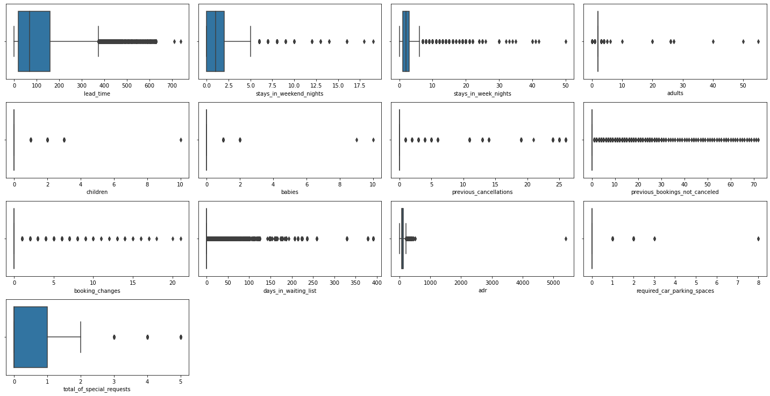

02. Data Cleaning
02. Removing Outliers
Outliers Exists
Outlier values are quite similar
Data from two hotels ??

Slide 12
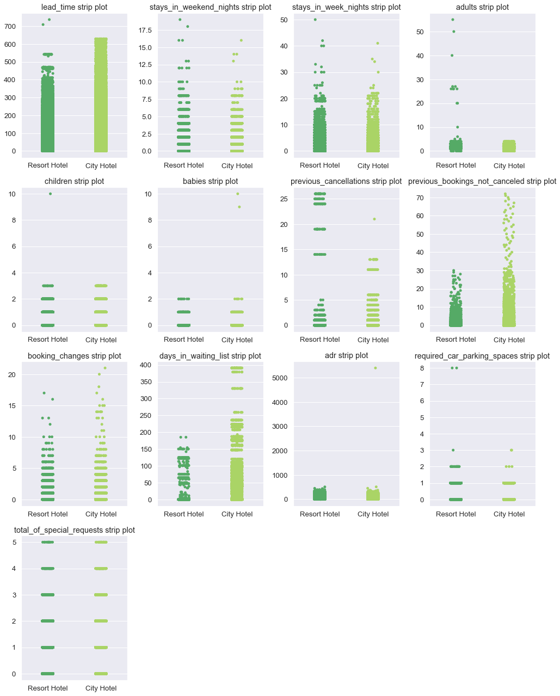

02. Data Cleaning
Creating Strip-plot to visualize differences in data distribution between the 2 hotels
Dropped rows with adr below 0 and above 5000
Dropped rows with 0 adults
Converted columns with unusual values into categorical
days_in_waiting_list,
previous_cancellations,
previous_bookings_not_canceled

Slide 13
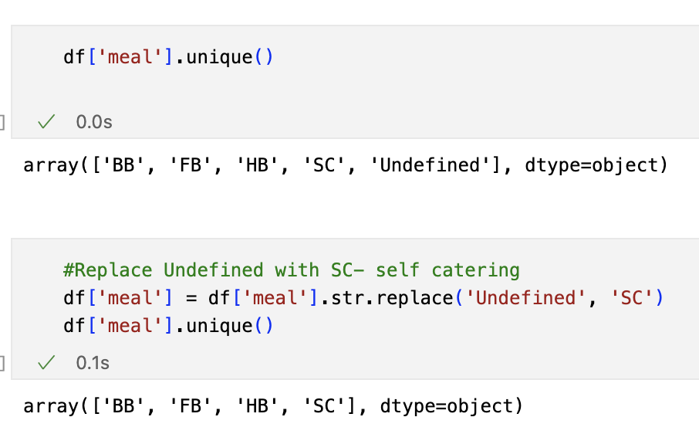
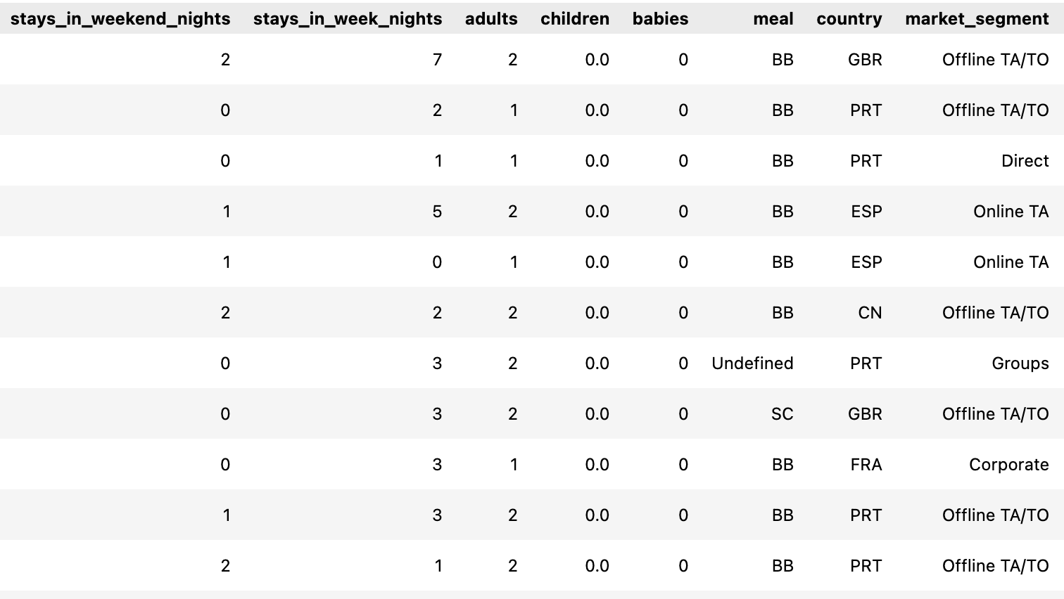
02. Data Cleaning
03. Removing Inconsistencies

Slide 14
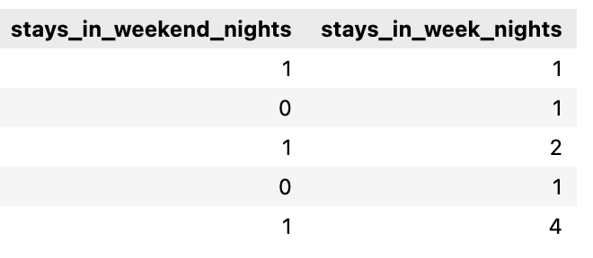
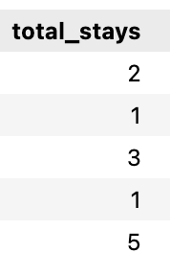
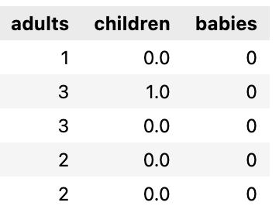
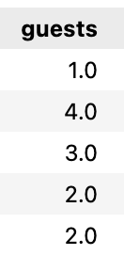
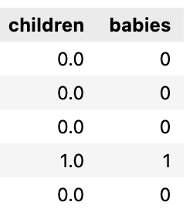
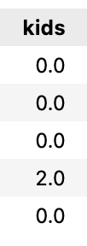
03. Data Transformation
01. Feature Engineering
Combined Features
Dropped redundant coloumns

Slide 15

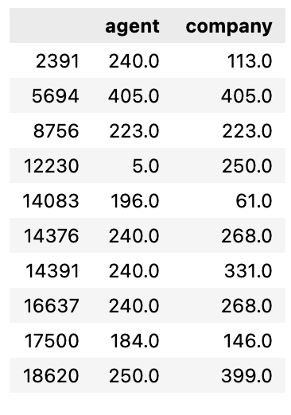

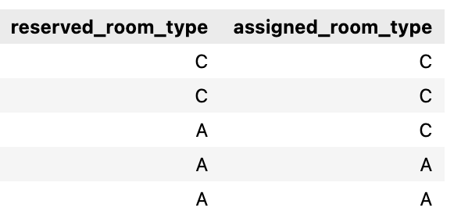
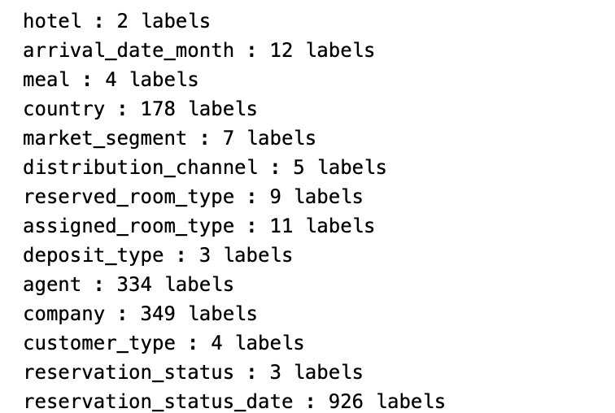
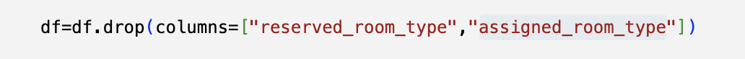

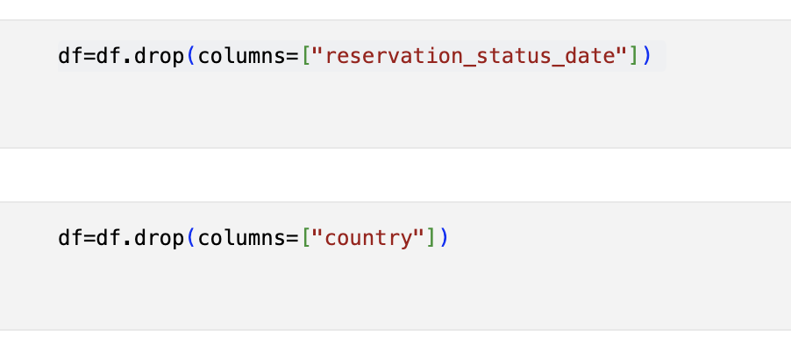
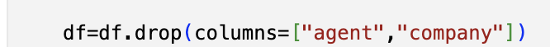


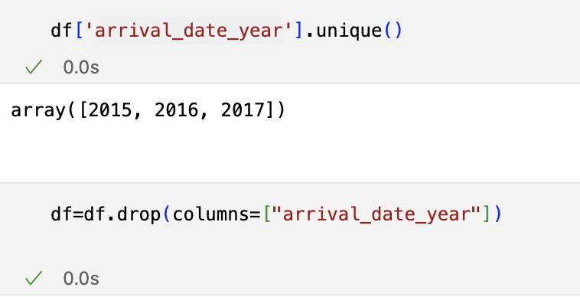
03. Data Transformation
02. Feature Selection
14 Categorical Features
The agent and company IDs are recorded
No information about Room Types
“country" feature excluded to avoid bias towards cancellation rates of specific countries.
Outdated features are removed

Slide 16
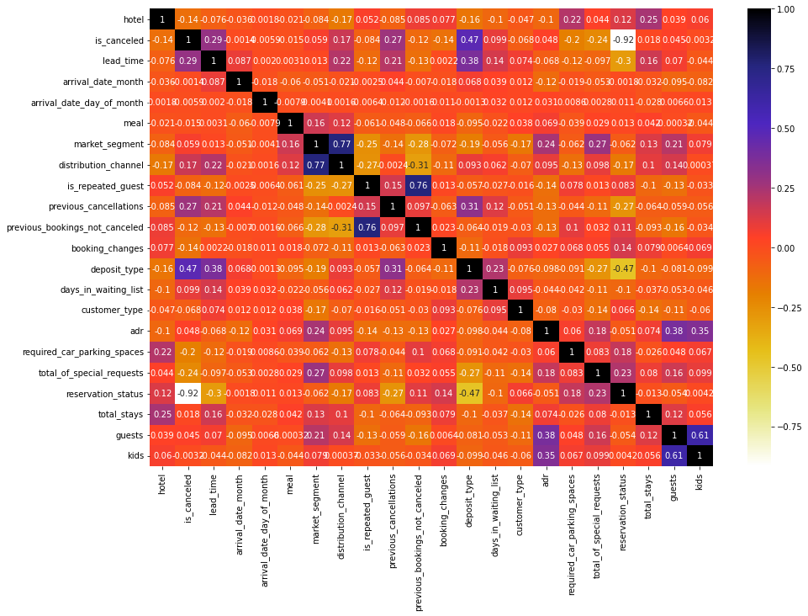
03. Data Transformation
03. Removing Correlated Features
Highly Correlated !
distribution_channel
market_segment
previous_bookings_not_cancelled
is_repeated_guest
reservation_status
is_cancelled

Slide 17
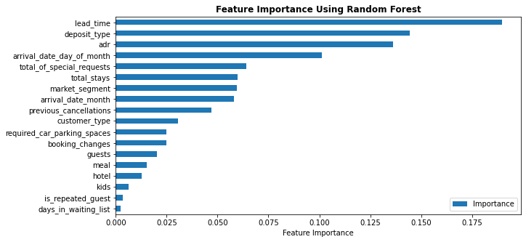
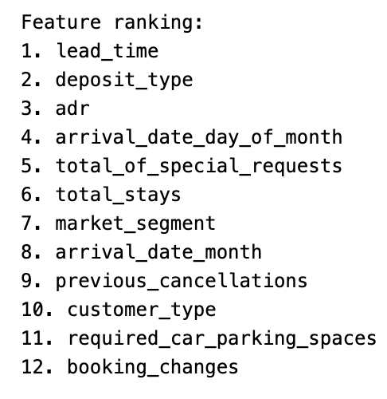
03. Data Transformation
04. Feature Importance
To 12 features for the model

Slide 18
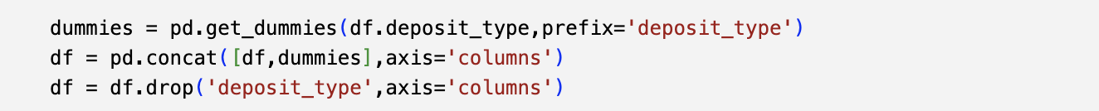
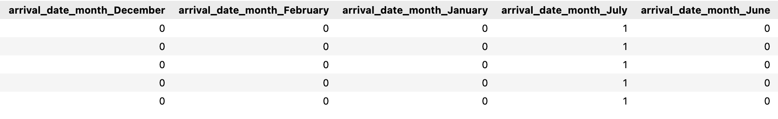
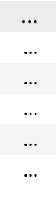
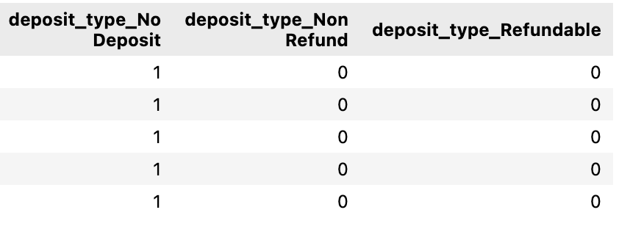
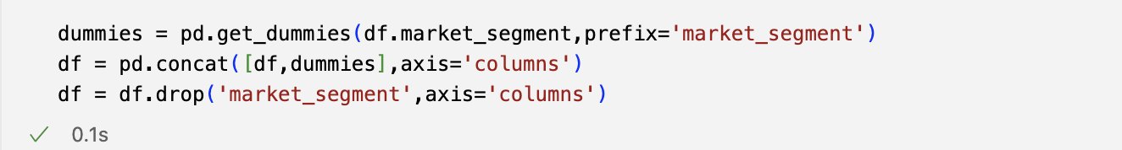
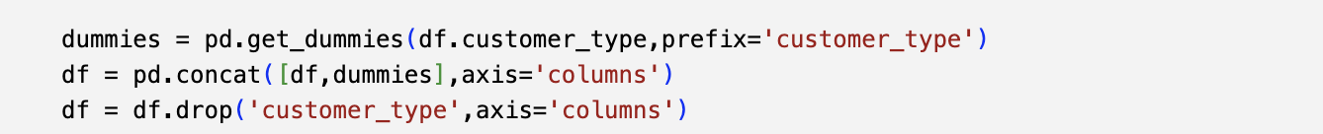
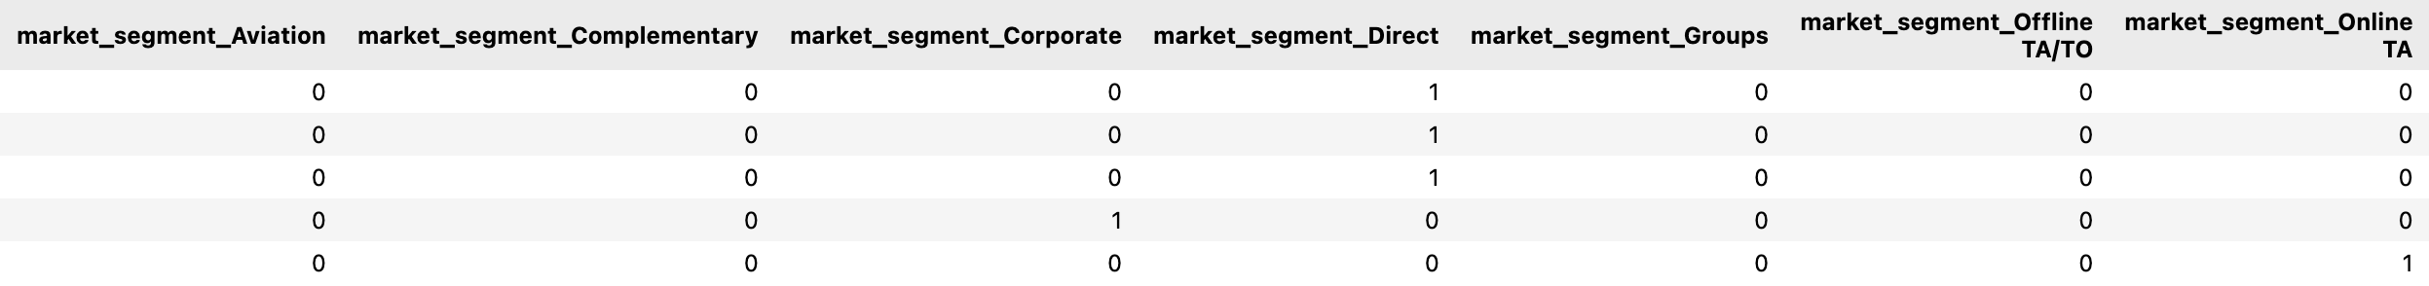
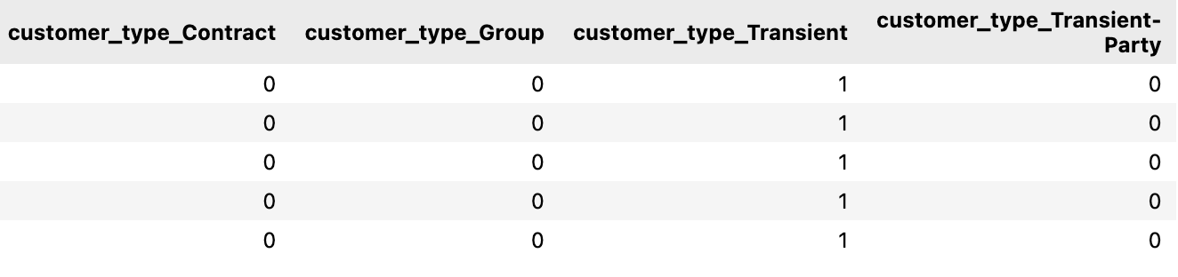
03. Data Transformation
05. One Hot Encoding & Creating Dummy Variables
Arrival Month
Deposit Type
Market Segment
Customer Type

Slide 19
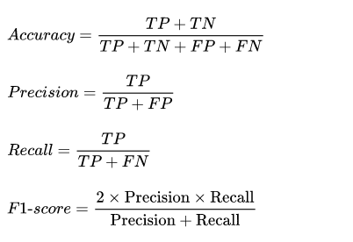

04. Model Building
01. Selection of Evaluation Metric
 | True Observation | False Observation
True Prediction | $123.0 (Predict canceled, cancelled) TP | -$183.00 (Predict canceled, not cancelled) FP
False Prediction | -$1830.00 (Predict not canceled, cancelled) FN | $123.0 (Predict not canceled, not cancelled) TN
On average each room costs ~$102
Median number of nights stayed by a guest is 3.
Gross profit =$306
Assuming a revenue of 40% from gross profit, the hotel can expect to make $123/stay
Risk of Flase Postives (-$183) and False Negatives (-$1830)
Balancing false positive and false is a necessity
Accuracy
F1-Score
Notes:
To select the appropriate evaluation metric, we need to understand about the risk of false negative and false positive in our prediction case. In short term point-of-view (POV), false negative of booking cancellation prediction is more likely resulting in profit-loss because of unnecessary preparation of the hotel towards non-existent customer. But in the long term POV, failing to prepare for the customer's arrival also will reduce our customer's experience, resulting in unseen profit/opportunity-loss in the future (false positive). So, balancing false positive and false negative (F1 score) is necessity for this prediction model building

Slide 20


04. Model Building
02. Data Imbalance Analysis
Compare several different types of balancing in combination with several different types of machine learning models
Balancing Methods
None
Random Under Sampling
Random Oversampling
SMOTE
SMOTE + Random Under Sampling
63%
37%
Machine Learning Models
Logistic Regression as basic binary classification model
KNN as instance-based machine learning model
Random Forest as bagging ensemble method
XGBoost as boosting ensemble method
Imbalance in the classes is not extreme, but it is not insignificant.
Which Balancing Method Works ??

Slide 21
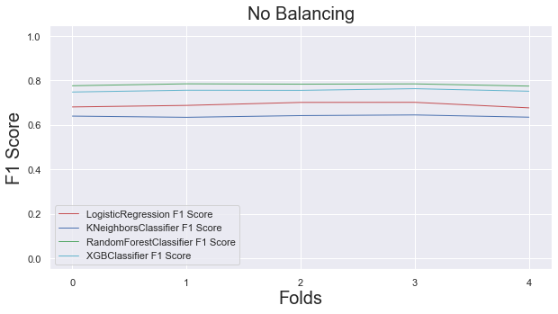
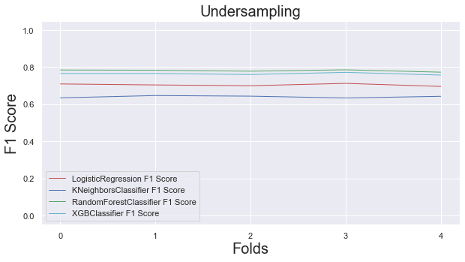
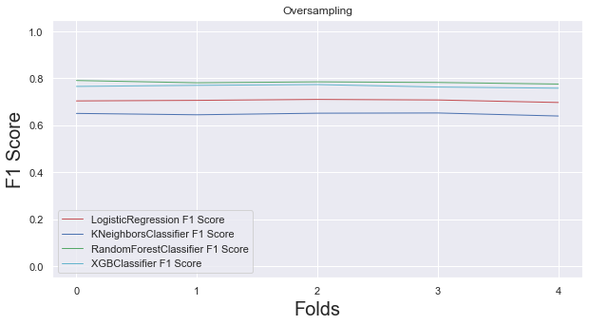
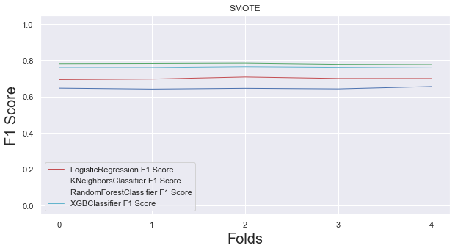
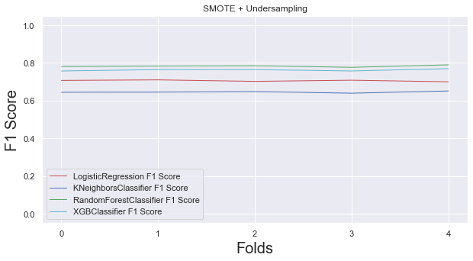
04. Model Building
Which Balancing Method Works ?
Undersampling
Oversampling
No Balancing
SMOTE
SMOTE + Undersampling
Not Balancing

Slide 22
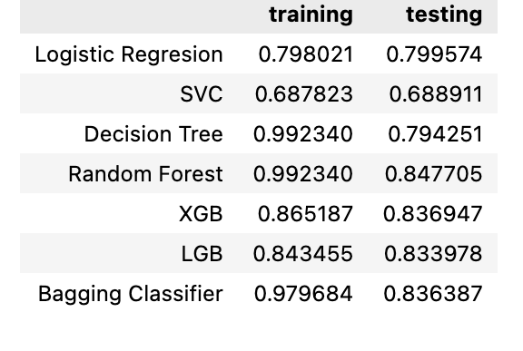
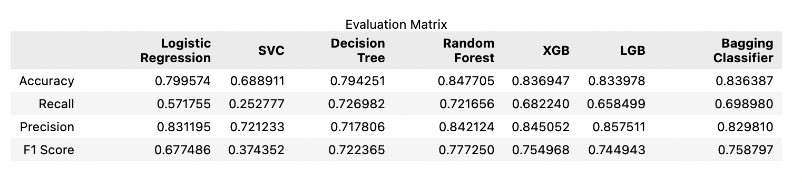
04. Model Building
03. Machine Learning Models
Logistic Regression
Support Vector Classifier (SVC)
Decision Tree
Random Forest
eXtreme Gradient Boosting (XGB)
Light Gradient Boosting (LGB)
Bagging Classifier
Overfitting

Slide 23
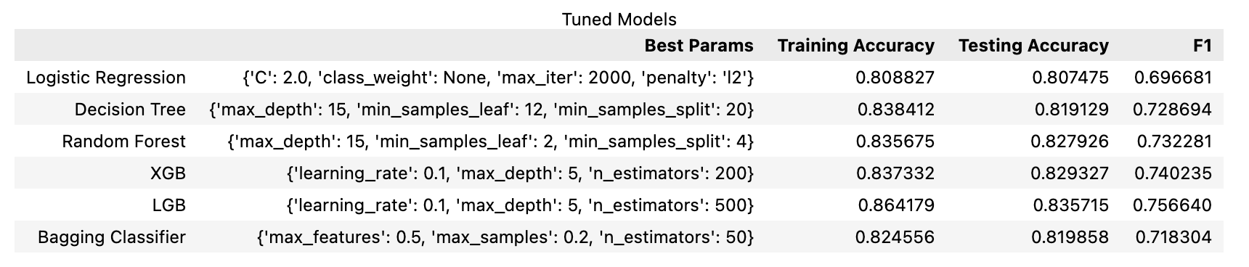
04. Model Building
04. Hyper Parameter Tuning with Grid Search CV & Results

Slide 24
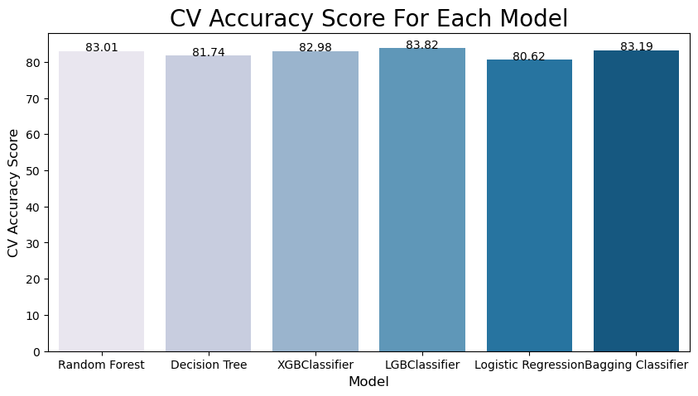






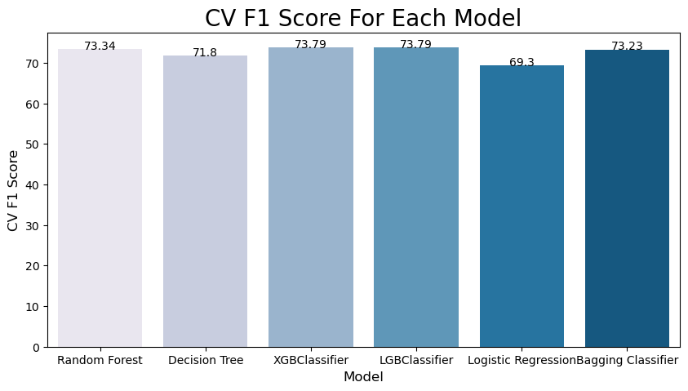
04. Model Building
05. Dataframes to represent Cross Validation Score of Accuracy and F1-Score

Slide 25
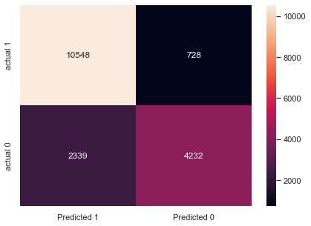

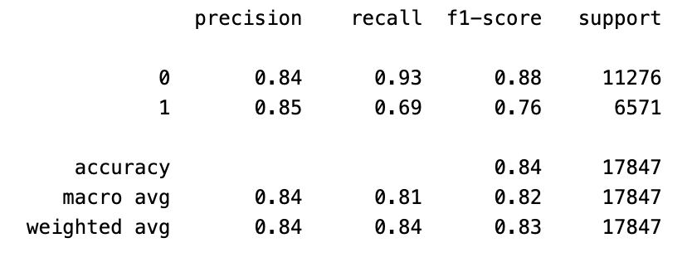
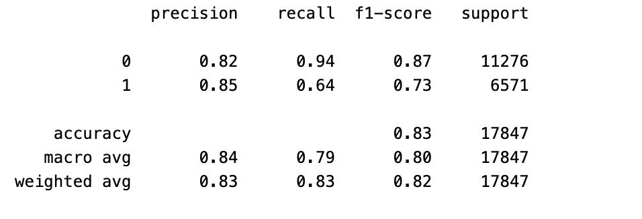
04. Model Building
02. Confusion Matrices
XGB Model
LGB Model

Slide 26
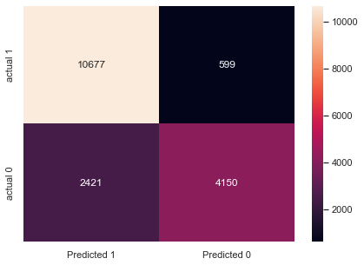

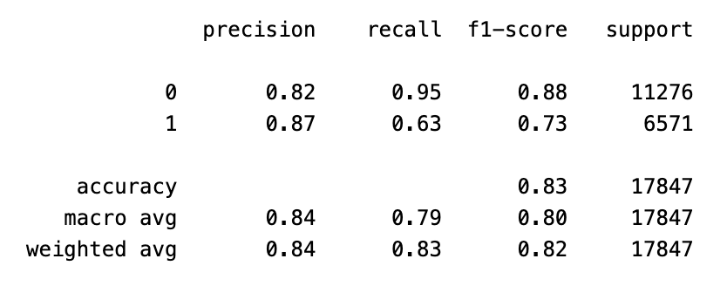
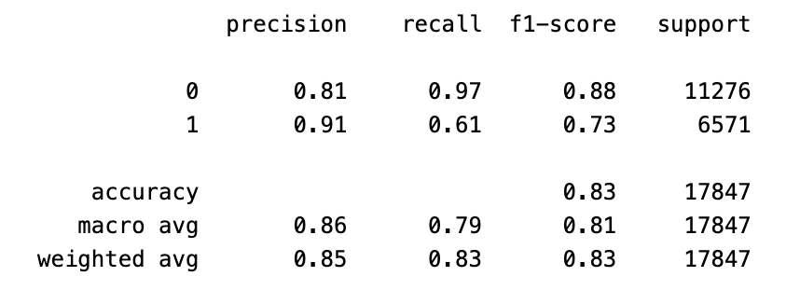
04. Model Building
Random Forest Model
Bagging Classifier Model

Slide 27

04. Model Building
LGB Model
Random Forest Model
XGB Model
03. Building Ensemble Model
Voting Classifier
1: X%
0 : (100-X)%
1 : Y%
0 : (100-Y)%
1 : Z%
0 : (100-Z)%
Average of 1 : ((X+Y+Z)/3)%
Average of 0 : ((300-X-Y-Z)/3)%
Cross Validation Accuracy Score : 85.30%
Standard deviation of cross-validation scores : 0.0045
Cross Validation F1-Score : 78.34%
Final Prediction
Notes:
https://vitalflux.com/hard-vs-soft-voting-classifier-python-example/

Slide 28

04. Model Building
03. Building Ensemble Model
LGB Model
Random Forest Model
Bagging Classifier
Stacking Classifier
P1
P1
P1
Meta-Classifier
Final Prediction
Cross Validation Accuracy Score : 84.85%
Standard deviation of cross-validation scores : 0.0049
Cross Validation F1-Score : 77.62%
c
Higher Accuracy
Higher F1-Score
Stacking Classifier

Slide 29
04.Results

Slide 30



Stacking Classifier Classification Report
Stacking Classifier
Cross Validation Accuracy Score : 84.85%
Standard deviation of cross-validation scores : 0.0049
Cross Validation F1-Score : 77.62%
ROC Curve of Stacking Classifier
Stacking Classifier Confusion Matrix

Slide 31









Expose the Model as an API Endpoint
Exported the model into a pickle file
Created a Flask Application
Loaded the pickled model in Flask.
Developed an endpoint to receive requests.
Built the Docker image with Flask and the model
API Request :
API End Point
Model
Pickle File
Prediction Req
Successful Response :
Prediction Resp

Slide 32




Exploratory Data Analysis
01. Univariate Analysis
~40% customers home country was Portugal
63%
37%
Average cancellations are 37% and deviates by 48%. Lots of variations !
~75% Customers belongs to Transient type
~47% of booking were done from
Online Travel Agents
Notes:
Average cancellations are 37% and deviates by 48%
Lots of variations
World map shows the country wise distribution of customers and for about 40% customers home country was portuagal.
75% of customers belongs to transient type, meaning bookings that were not part of group or contract
Out of the 7 market segments, most of the bookings about 47% was done from online Travel Agents
Regarding Customers, 75% of people ask for one special request
Mean value of adults are children are higher in resort hotels, so resorts are the better choice for large families
Custoer Type Transient has the highest number of cancellations. It can be seen more the number of days take for the lead time, more cancellations were made.
We looked for seasonality trends and found that more number of bookings were ade in moth of august

Slide 33




Exploratory Data Analysis
02. Bi-Variate Analysis
Why does Non Refund Deposit Type Are More Likely to Cancelled ?
Longer lead time
Longer lead time results in more cancellations !
Customers who comes in Groups are less likely to Cancel
Notes:
Why does Non Refund Deposit Type Are More Likely to Canceled

Slide 34




Exploratory Data Analysis
02. Bi-Variate Analysis
Booking that has no special request are more likely to cancelled
Booking that's been previously cancelled are more likely to be cancelled again !
Bookings required a parking space will high likely to be confirmed
Customer Who made booking Changes to their booking have a lower cancellation rate
Notes:
booking that required a parking space will high likely to be confirmed
booking that has no special request are more likely to canceled
Customer Who made booking Changes to their booking have a lower cancellation rate

Slide 35

Exploratory Data Analysis
03. Multi-Variate Analysis
Seasonality Trends
A greater number of bookings were made in moth of august
Number of cancellation generally goes up as the number of booking goes up
Notes:
We looked for seasonality trends and found that more number of bookings were ade in moth of august

Slide 36





Exploratory Data Analysis
04. Customer Loyalty
Repeated guests come in Groups
Repeated guests dissatisfied
~3% of Repeated Guests
Non Repeated Guest are more than 2X more likely to cancel
Repeated guests have less Lead Time
Notes:
The data can tell whether a customer is a repeated guest or not. Help us to derive underlying patterns and highlighted behaviours
Most of the customers on avarage stayed for about 1-4 days, of those very few were repeated customers. It seems that repeated guests did not found the hotel promising. Mangemnet should focus on repeated guests. Also great number of repeated guests come in groups and have less lead time. Therefore investing in repeated guests is beneficial for the hotel.

Slide 37
06. References
[1]Condor Ferries, “65+ Hotel Industry Statistics & Trends (2020),” Condor Ferries, 2020. https://www.condorferries.co.uk/hotel-industry-statistics (accessed Mar. 11, 2023).
[2]“Hotel cancelation rate at 40% as online travel agencies push free change policy,” www.phocuswire.com. https://www.phocuswire.com/Hotel-distribution-market-share-distribution-analysis#:~:text=The%20average%20cancelation%20rate%20in (accessed Mar. 10, 2023).
[3]T. J. McCue, “Stop Losing Money When You Have To Cancel Hotel Reservations,” Forbes. https://www.forbes.com/sites/tjmccue/2014/03/31/stop-losing-money-when-you-have-to-cancel-hotel-reservations/?sh=78ee51037ce3 (accessed Mar. 10, 2023).
[4]N. Antonio, A. de Almeida, and L. Nunes, “Predicting hotel booking cancellations to decrease uncertainty and increase revenue,” Tourism & Management Studies, vol. 13, no. 2, pp. 25–39, Apr. 2017, doi: https://doi.org/10.18089/tms.2017.13203.
[5]N. Antonio, A. de Almeida, and L. Nunes, “An Automated Machine Learning Based Decision Support System to Predict Hotel Booking Cancellations,” Data Science Journal, vol. 18, 2019, doi: https://doi.org/10.5334/dsj-2019-032.
[6]Md. S. Satu, K. Ahammed, and M. Z. Abedin, “Performance Analysis of Machine Learning Techniques to Predict Hotel booking Cancellations in Hospitality Industry,” 2020 23rd International Conference on Computer and Information Technology (ICCIT), Dec. 2020, doi: https://doi.org/10.1109/iccit51783.2020.9392648.
[7]M. Adil, M. F. Ansari, A. Alahmadi, J.-Z. Wu, and R. K. Chakrabortty, “Solving the Problem of Class Imbalance in the Prediction of Hotel Cancelations: A Hybridized Machine Learning Approach,” Processes, vol. 9, no. 10, p. 1713, Sep. 2021, doi: https://doi.org/10.3390/pr9101713.
‌

Slide 38
06. Conclusion
Hotel cancelation models = less risk + more sales.
Models help managers prepare for cancellations = better decisions.
Machine learning improves accuracy = benefits for hotels and customers.

Slide 39

THANK YOU !
Do You Have Any Questions?

